Slide 1
POLS 207 State & Local Government*
Chapter 11A
Adjudicating the Law: Policy and the Courts (Part 1)
Dr. Roblyer, Ph.D.
*These slides are based on originals provided by Dr. Harvey Tucker

Slide 2
Learning Objectives
Compare and contrast the following aspects of criminal and civil law:
Origin of cases
Parties involved and their objectives
Percent of cases that go to trial
Location of trials
Bases of decisions/outcomes
Overview the prosecution process under criminal law.
Describe the similarities and differences between the two types of criminal offenses in Texas.
Using the fallen-tree example, highlight the aspects of the civil trial process that are unique from a criminal one.
Discuss the case loads of both federal and state courts and explain the differences.
Describe the hierarchy of three main groups of state courts.
Explain the types of questions considered in each of these levels. Provide examples. Also explain the implications of a type of question NOT being considered at a particular level.

Slide 3

Wrongful Acts Taken to Our Courts
Two types of law: criminal & civil
Can sometimes be applied to same wrong
Criminal Charge:
Murder
Civil Suit:
Wrongful Death
http://imgarcade.com/1/court-house-clip-art/

Slide 4
Criminal Acts that break State Law
Criminal law deals with actions harmful to society as a whole
The State is both accuser and prosecutor
State’s representative is the district attorney, an elected member of each county’s government
Prosecution is multi-step, very lengthy process
Arrest made
Charge(s) filed, arraignment hearing held
Evidence presented to grand jury, indictment returned
Trial process begins (multiple hearings, then trial)
Can take a year or more!

Slide 5
Criminal Acts that break State Law
Only 10% of cases ever go to trial
Most cases end in plea bargain
Trials held in county courtrooms with county prosecutors and judges, but cases are “the State of Texas vs. ____”
The county pays all costs of prosecution & county incarceration (state pays for prisons & inmates there)
Standard of guilt: “Beyond a reasonable doubt”
“Guilty” finding leads to possible jail/prison time and/or fines, etc.
Any fines levied go to the county
…Why?

Slide 6
Criminal Acts that break State Law
Two “levels” of crimes in Texas
Misdemeanors – Less serious punishment: shorter times in county jail, community service, and/or fine
Initiated by “complaint” from county/district attorney
No grand jury involvement
Felonies – More serious punishment: longer sentences in state prison or county jail, community service, and/or fine
Initiated by “charge” from district attorney
Grand jury decides if evidence justifies prosecution
“State jail felonies” will send a convicted person to county jail, most likely

Slide 7
Wrongful Acts Against “a Person”
Civil law is basis for legal disputes between “individuals” over unmet obligations or perceived harms that either cannot or will not be prosecuted under criminal law
Plaintiff files complaint or legal suit against defendant
Rationales: Personal injury, contractual violations, divorce, etc.
Objectives: Monetary damages, determination of rights, etc.
“Loser” must compensate “winner”
Standard for judgment: “preponderance of evidence”
Civil cases may apportion responsibility for loss (multiple parties can be held responsible)
Corporations are treated as individuals in civil law
Most disputes involving businesses are civil cases
…what’s that?

Slide 8
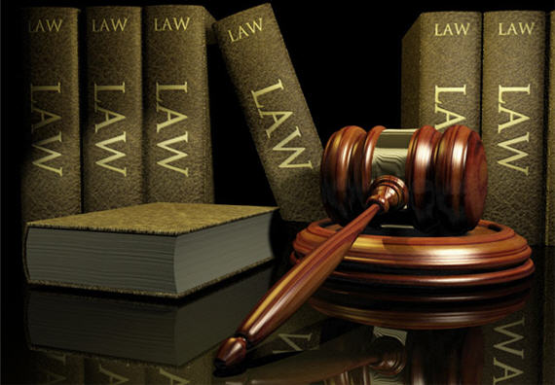
Example of a State Civil Case
I have a dispute with my neighbor, whose car was demolished by a tree from my property
My neighbor sues me, claiming I caused harm
At the civil trial, there was testimony that I was seen shouting at the neighbor and later I had rented a chainsaw
Am I partially or totally responsible?
http://www.outsidethebeltway.com/just-say-no-to-special-prosecutors/law-books-gavel-19/

Slide 9
Example of a State Civil Case
At trial, my attorney brings out these facts:
Dead tree was a known hazard
Part of my purchase contract required removal by previous owner, but it was not done
I had told neighbor about hazard—I had shouted because he is almost completely deaf
I had hired a bonded, professional tree cutter, but his chain saw was being repaired
I rented a saw for him to use the next day, but the tree fell on my neighbor’s car that night during high winds
Am I totally or partially responsible?
http://www.outsidethebeltway.com/just-say-no-to-special-prosecutors/law-books-gavel-19/

Slide 10
Dual Court Systems
Federal courts handle issues under federal law
Hear very few cases compared to state courts
State courts handle issues under state law
99.9% of 22 million criminal cases in US annually
99.8% of 27 million civil cases nationwide annually
Why? …because state law governs most aspects of citizens’ daily lives
Texas has only 2600 courts to handle its share of the load
This is the REAL reason that so many cases end in plea bargains
Even IF Texas had only 1/50th of the 50 million cases annually, how could it court system not implode without vast majority of cases ending in plea bargains?

Slide 11
Typical Configuration of State Courts
Supreme Court
Intermediate Appellate Court
We’ll start here…
Trial Courts

Slide 12
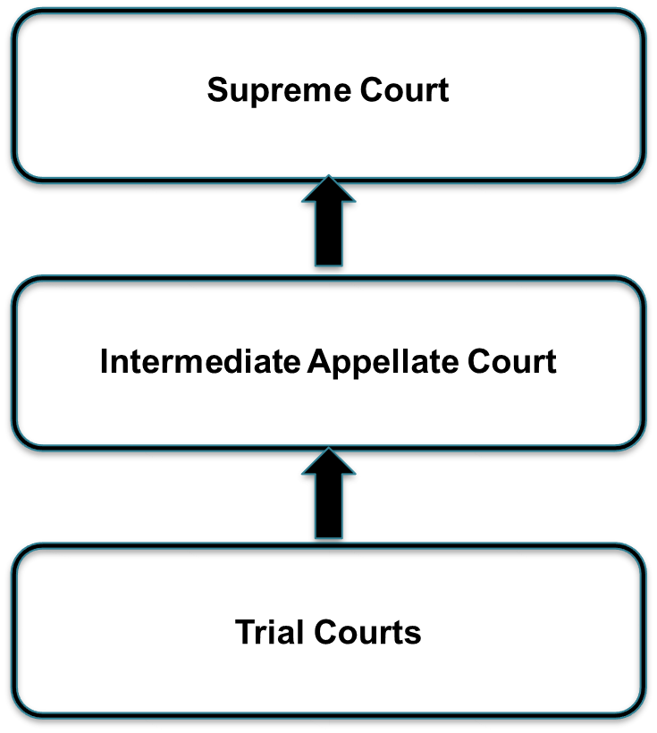
State Courts
Original-jurisdiction or trial courts deal with 2 types of questions:
Questions of fact
Answered by jury if a jury trial, otherwise by judge
Example: Where was the accused that night?
Example: Did the accused commit that crime?
Questions of law
Always answered by judge
Example: Is that item of evidence admissible?
Example: May the attorney ask that question?

Slide 13
State Courts
Courts of appeal hear objections to lower court decisions
Appeals can only be based on the trial judge’s decisions about questions of law
No juries; multiple judges review trial court record
Both parties and “friends of the court” present briefs (rationales for deciding one way or another)
Panel of judges hold hearing (not trial)
Either upholds or reverses lower court judgment
Can’t set defendants free, but can “remand” (return) cases back to trial court and issue instructions to that lower court

Slide 14
Practice Problems …to begin mastering this material. Complete instructions are in the Module 1 resource, How to Use Practice Problems to Prepare for Exams.
Don’t forget to do the…

